Slide 1
Family history and pancreatic cancer
Dr Alina Stoita
Gastroenterologist
St Vincent’s Hospital Sydney

Slide 2
Who is at high risk?
10 % pancreatic cancer due genetic predisposition:
  FAMILIAL Pancreatic cancer
  Inherited pancreatic cancer syndromes
  Screening programs target individuals with a 5% or greater lifetime risk of pancreatic cancer

Slide 3
Familial pancreatic cancer
 | Standardised incidence ratio (95% CI) | LIFE TIME RISK %
≥ 3 FDR | 32 (10-75) | 40
2 FDR | 6.4 (1.8- 16.4) | 8-12
1 FDR | 4.5 (0.54-16.3) | 4.6
General population | 1.0 | 1.3
National Familial Pancreas Tumour Registry, JHH
  Mean age diagnosis PDAC, 68yo
  Anticipation: younger age of onset in PDAC offspring (57 v 68)
  Risk increases with decreasing age of onset in kindred
  Smoking: increases risk 2-4 fold, lowers age onset by 10 years

Slide 4
Inherited pancreatic cancer syndromes
 | MUTATION |  | LIFETIME RISK
Hereditary pancreatitis | PRSS1 | Cationic trypsinogen gene | 49-55%
Peutz-Jeghers | STK11/ LKB1 | Tumour suppressor/ serine threonine kinase | 11-36%
FAMMM | P16/CDK2NA | Tumour suppressor | 16%
Breast ovarian cancer syndrome | BRCA 2 / 1 | Tumour suppressor | 5% / 3.6
Lynch syndrome | MLH1, MSH2, MSH6, PMS2 | Mismatch repair | 3.7
Notes:
Is associated with

Slide 5
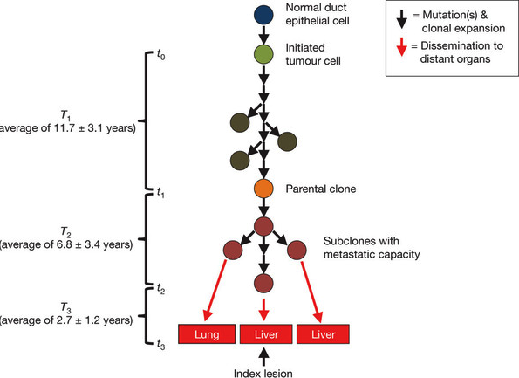
Rationale for screening
10Y between the initial mutation and the birth of first pancreatic cancer cell and another 6 years for the development of the clone with metastatic potential
Broad window of opportunity for early detection to prevent deaths from metastatic disease Hruban, NATURE, 2010
Notes:
What is the rationale for screening?
From a paper published by Hruban in Nature in 2010 we know there is a 10 y interval….
That means there is a a broad window of opportunity to early detection of PC

Slide 6
Aim of screening
International Cancer of the Pancreas Screening (CAPS) consortium was formed in 2010 to help organize global pancreatic cancer screening
Consensus guidelines for the management of patients at risk of PC were published in Gut 2012
GOALS 1. Detect and treat T1N0M0 margin negative PC (Japan 100% 5 y survival T1NoMo)
2. Detect Precancerous lesions high grade dysplastic lesions (IPMN, PaniN3)
Test accurate, cheap -- IMPROVE SURVIVAL
Notes:
In 2010, 50 experts, 10 countries formed an international consortium to help organise global PC screening
Guideliness made from literature rv and expert opinion consensus and were published in Gut 2012

Slide 7
Australian Pancreatic Cancer Screening Study
St Vincent’s Hospital Sydney 2011, Austin Hospital 2013
Collaboration
  Australian Pancreatic Genome Initiative (APGI)
  Garvan Institute
  Pancreatic Cancer Network
Australian Familial Pancreatic Cancer Cohort REGISTRY (AFPaCC)
www.pancreaticcancer.net.au
Notes:
7
Follow the CAPS protocol
Were involved in developing the registry
Role of the registry
Study DNA in those familiesUnderstand the risk factors in those families
Enroll eligible patients in the screening trials

Slide 8
Australian protocol
Identify high risk individuals
*EUS Surveillance
Nodule, mass, cyst: 3-6mthly
CP changes: 6 mthly
#Psychological questionnaire
Genetic counselling
+/- gene mutation analysis
History, bloods
EUS
NORMAL
ABNORMAL
Yearly EUS
MDT +/-MRCP
Surgery
Close surveillance*

Slide 9
St Vincent’s Results
120 assessed
76 enrolled and had EUS
AGE: 50 or 10y younger than PC
START AGE 50 or 10 y younger than PC
 | Number patients
1 FDR, multiple SDR | 26
2 FDR | 24
3 FDR | 8
BRCA 2, FDR | 17
PJ | 1
Notes:
Start age 50

Slide 10
Who enrolls?
Educated individuals::all have high school degree or higher or have sibling with higher degree
Caucasian ( 1 hispanic, 1 asian)
Male/ Female 23/53
Mean age 55 (35-78)
Jewish heritage 4 pt ( both parents Ashkenazi)
Smoking (7 current)
Alcohol ( 4 people drink for than 3std/day)

Slide 11
EUS findings SVH
* diagnostic yield 26%
N=76 | No (%)
NORMAL | 37 (49%)
CYSTS/BDIPMN* | 15 (19%) | Mean 6mm ( 3-12mm)
Focal Hypoechoic lesions*, FNA | 6 (7%) | 4-6mm,FNA no dysplasia
Ch pancreatitis CP only CP +Cyst | 23 (30%) 10 (13%) 13 ( 17%)
Incidental findings | 4 | HEPATOMA, BREAST CA, GIST, coeliac
Interval change : 10 pt developed new cyst, cysts increase in size or existing cysts turned up to be BD-IPMN
Notes:
Talk about 2 cancers

Slide 12
Austin Results
33 enrolled
10 have abnormalities warranting further imaging or more frequent EUS
2 pt have ethics approval for surgery
 | Nr of participants | More intense surveillance
1FDR,multiple SDR | 14 | 1
2 FDR | 25 | 6
3FDR | 5 | 3
FAMMM | 1 | 0
BRAC2,FDR | 1 | 0

Slide 13
Counseling
Majority found genetic counseling useful and would recommended it to a family member
Almost ALL would like to be tested for PC gene if found
All patients rated their individual risk of PC moderate or high and were anxious about it
Anxiety about PC post procedure has reduced

Slide 14
Problems with screening
Lesions can be identified but we don’t know the natural history of these lesions in HRI..
Need a biomarker cheap, reliable
Avoid risk of “unnecessary” resections ( only aprox 35% of patients have HGD at surgery )
Screening should be performed in prospective research studies

Slide 15
Where do we go from here?
Look at the patient as a WHOLE- require uptodate screening for breast cancer, bowel cancer , cervical cancer and prostate cancers
Start screening at 50
Focus of higher risk ≥2 FDR , BRCA 2
Modify reversible factors
Stratify once baseline EUS done

Slide 16
What can you do ?
Don’t smoke,
Avoid being overweight
Exercise 2 -3 x week
Avoid food with artificial colouring and preservatives, sugary carbonated drinks
Eat fresh fruits and vegetables
Make sure up to date for mammograms, pap smears, prostate check and colonoscopy every 5 y
If high risk enroll in a screening program

