Slide 1




Slide 2


Pancreatic Cancer Support Service
Patient and Family Support Service
Erica Ruck & Margarate Lees
Nurse Network Program

Slide 3
Pancreatic Cancer Support Service

Slide 4
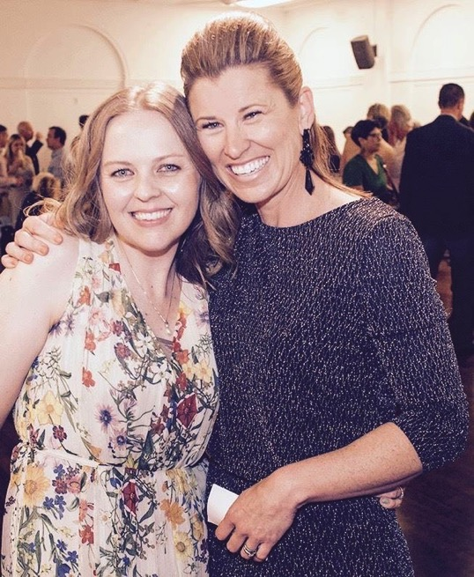
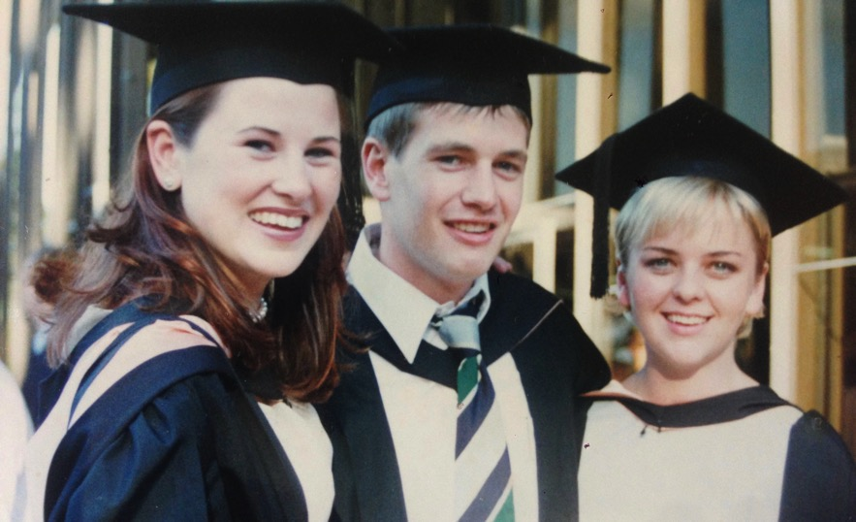

Slide 5

Good old fashioned care
Case management nurses are registered nurses who coordinate all aspects of the care of individual patients.
They ensure proper utilisation of services and resources as well.
Case managers provide assistance within, between, and outside of facilities.
Nurses working in case management facilitate outstanding patient care using fiscally responsible strategies.
They are experts at obtaining resources.
Case managers work with patients, families and other professionals where necessary.
Case managers need to be savvy communicators, well organised, and creative.

Slide 6
What a case manager hears

Slide 7
Pancreatic Cancer Support Service

Slide 8
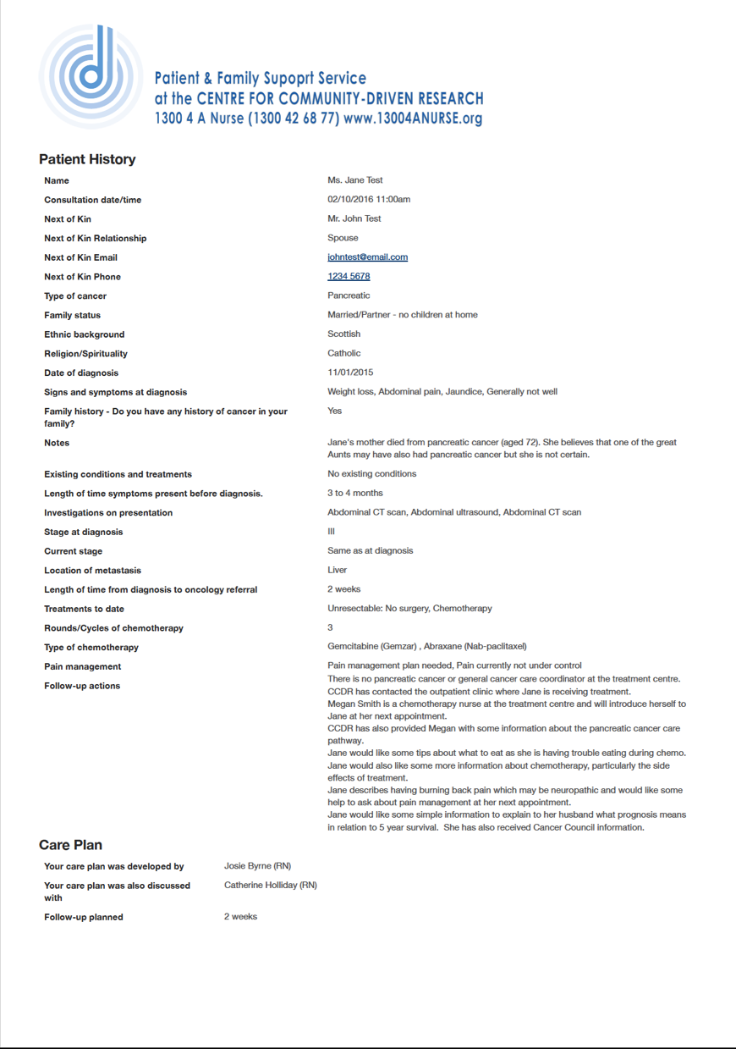
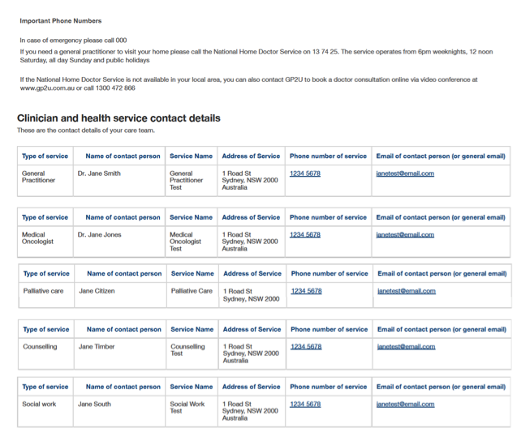
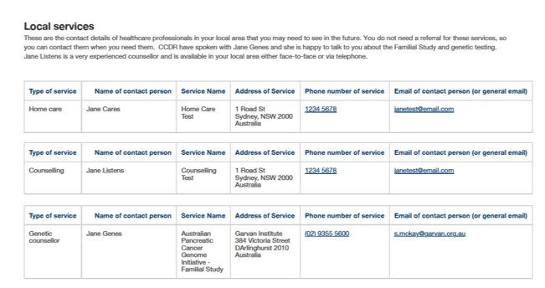

Slide 9
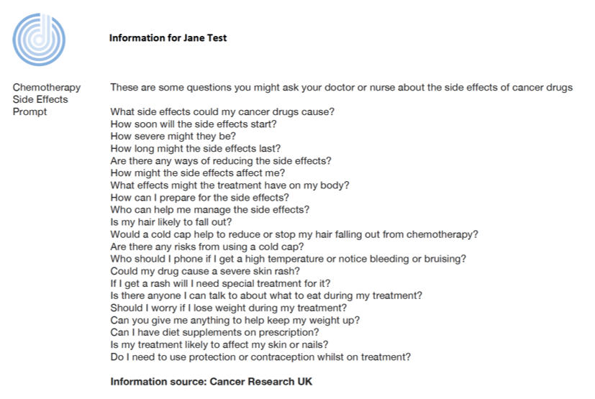
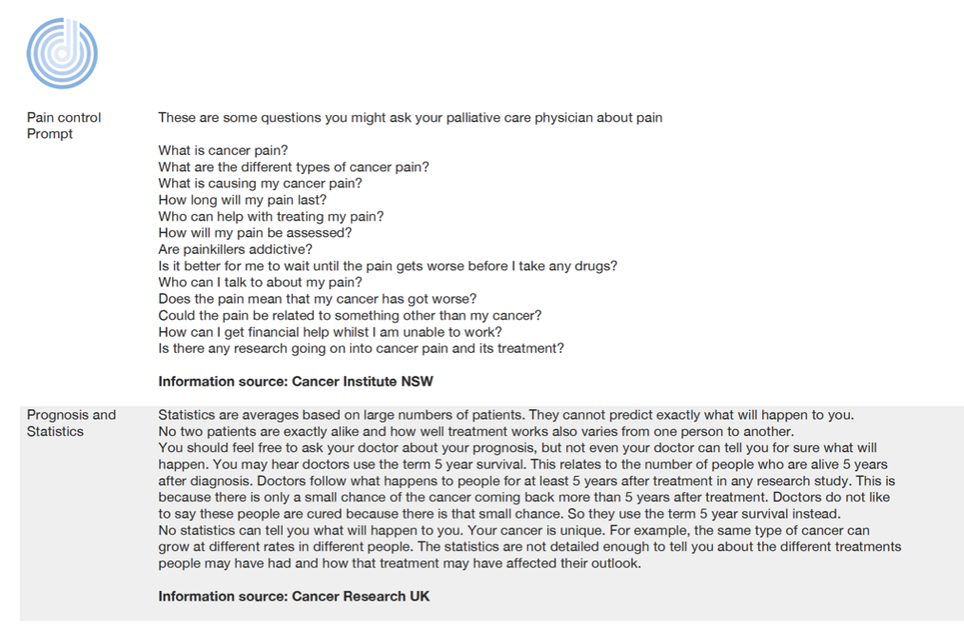

Slide 10

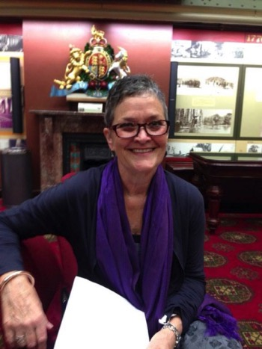
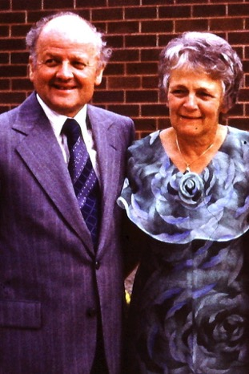
Nurse Network
10 nurses (5 rural/5 metro)
Case discussion
Clinical presentation
De-brief

Slide 11
Next
- Family history charts
- Research translation
- Community-driven research support
- Clinical trial support

Slide 13



pancreatic-cancer.support
nurse@cc-dr.org
1300 42 68 77 (1300 4 a nurse)

