Slide 1
An update on clinical trials and personalised medicine for pancreas cancer in Australia Lorraine Chantrill Medical Oncologist Macarthur Cancer Therapy Centre Kinghorn Cancer Centre Chair, Upper GI working party AGITG APGI 18 June 2016
CANCER PROGRAM

Slide 2
APACT clinical trial of adjuvant therapy for resected pancreas cancer
The APACT (Adjuvant Pancreatic Adenocarcinoma Clinical Trial) study has reached its global enrollment target of 800 subjects as of the 7th of March 2016. APACT is a Celgene sponsored, phase 3 randomised, open-label, multicentre study evaluating the use of adjuvant nab-paclitaxel plus gemcitabine compared to gemcitabine alone in patients with surgically resected ductal pancreatic adenocarcinoma. Australia contributed 47 patients in total, ranking 5th globally.

Slide 3
Australian trials in progress: first line biological driven trial - IMPaCT
A collaborative, translational clinical trial
AGITG,APGI, Sydney Catalyst, NHMRC clinical trials centre with funding from many sources
3 molecular signals: Her2, BRCA2 mutation and WT KRAS

Slide 4
Notes:
4

Slide 5
Screening results
93 patients consented to screening
76 had sufficient tissue for analysis
22 candidates identified
14 KRAS WT
5 HER2 amplified
2 BRCA2 mutations
1 ATM mutation

Slide 7
Change the study to accommodate patients needs better
Allow patients to commence treatment with the standard of care whilst awaiting results
Remove the requirement for randomisation
Simplify as far as possible the testing to make it as fast as possible

Slide 8
IMPaCT
Eligibility
Males or females enrolled in APGI with confirmed adenocarcinoma of the pancreas and have a molecular signature confirmed via genomic sequencing and protein expression
Patients are permitted to start therapy with gemcitabine or gemcitabine + nab-paclitaxel while awaiting results
Personalized treatment
HER2-positive subgroup
gemcitabine + trastuzumab
Homologous recombination defects subgroup
platinum-based therapy
KRAS wild-type subgroup
gemcitabine + erlotinib
Progression
per RECIST 1.1 criteria
Further treatment at
investigator’s discretion.

Slide 9
Publicity for failure!
The harsh reality of personalised medicine Date April 20, 2015 (29) Read later Amy Corderoy Health Editor, Sydney Morning Herald "When we first designed the study there was some scepticism regarding genomic data being used to influence treatments, says researcher Lorraine Chantrill. The whole world was counting on them. When Australia was chosen as the global team charged with mapping the genome of pancreatic cancer for the first time, doctors hoped the project would mark the start of a new era of "personalised medicine", where treatments are tailored to the genetic make-up of each patient's disease. But the treatment arm of the multimillion-dollar research program has failed at its first hurdle in NSW, unable to treat a single patient, despite the fact they started testing people more than five years ago. Read more: http://www.smh.com.au/nsw/the-harsh-reality-of-personalised-medicine-20150420-1mp3x6.html#ixzz47ex4iGz1 Follow us: @smh on Twitter | sydneymorningherald on Facebook

Slide 10
Subgroups of PDAC based on the
frequency and distribution of structural rearrangements.
Representative tumours of each group are shown. The coloured outer rings are chromosomes,the next ring depicts copy number (red represents gain and green represents
loss), the next is the B allele frequency (proportion of the B allele to thetotal quantity of both alleles). The inner lines depict chromosome structural rearrangements.
Whole genomes redefine the mutational landscape of pancreatic cancer
Waddell, Nicola
Pajic, Marina
Patch, Ann-Marie; Chang, David K; Kassahn, Karin S; et al. Nature 518.7540 (Feb 26, 2015):

Slide 11
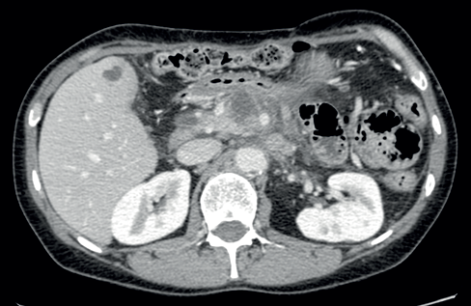
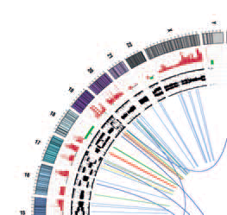
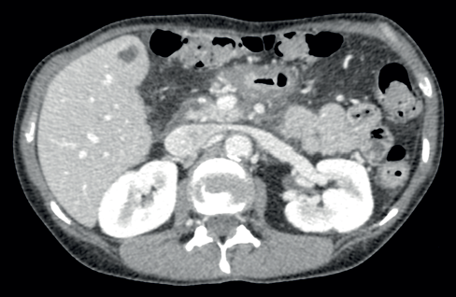
Treatment of the recurrence with FOLFOX resulted in an exceptional response with recanalization of the portal vein which was previously obliterated by tumour and resolution of the mass with complete normalization of CA19.9

Slide 12
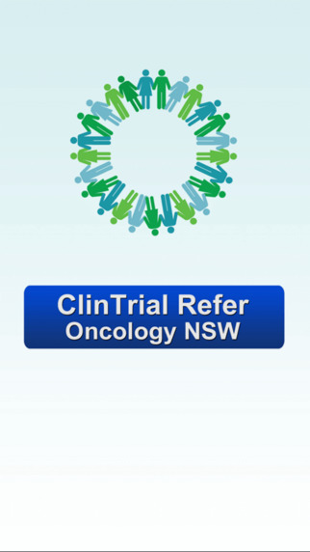

Slide 13
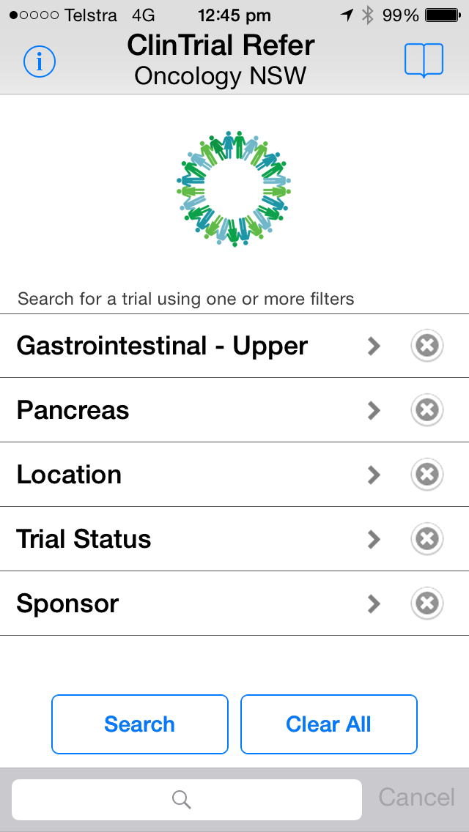

Slide 15
POLO: A randomized phase III trial of olaparib tablets in patients with metastatic pancreatic cancer (mPC) and a germline BRCA1/2mutation (gBRCAm) who have not progressed following first-line chemotherapy.

Slide 16
Yosemite
Delta-like ligand 4 (DLL4) activates the Notch pathway. DEM is a humanized IgG₂anti-DLL4 antibody that inhibits tumor growth & decreases cancer stem cell frequency in human tumor xenograft models.

Slide 17
HALO biomarker-driven
A Phase 3, Randomized, Double-Blind, Placebo-Controlled, Multicenter Study of PEGylated Recombinant Human Hyaluronidase (PEGPH20) in Combination with nab-Paclitaxel Plus Gemcitabine Compared with Placebo Plus nab-Paclitaxel and Gemcitabine in Subjects with Hyaluronan-High Stage IV Previously Untreated Pancreatic Ductal Adenocarcinoma

Slide 18
Creation of the pancreas cancer molecular MDT
Multidisciplinary tumour board
Team of professionals mainly from APGI and the pancreas cancer lab, but will expand to involve clinicians screening patients for trials
Documentation of molecular characteristics of tumour tissue including sequencing data for mutations, copy number variations as well as routine laboratory tests such as CISH and IHC
Establishing standard operating procedures and processes for informing clinicians of potential practice-changing molecular signals
Consolidating communication lines between APGI and clinicians and patients

